Slide 1
M. Tech (CSE) – Second Semester (Term: June - Oct 2022)
20Marks Component Presentation
on Qiskit, Partners, Goal, and It’s application – Sampler primitive program and estimator primitive program – Error handling ways used by Qiskit API
Department of Computer Science and Engineering
Presented By:
Haneena Fathima
[1MS21SCS07]

Slide 2
What is Qiskit
Open-Source Quantum Development
Qiskit [kiss-kit] is an open-source SDK for working with quantum computers at the level of pulses, circuits, and application modules.

Slide 3
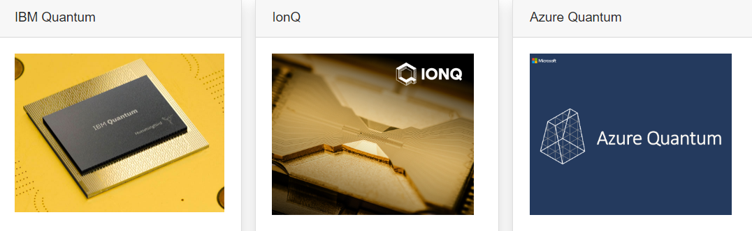
Partners of Qiskit
Hardware partners :

Slide 4
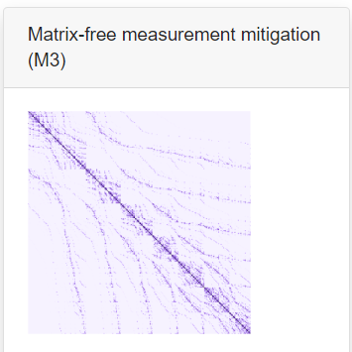
software partners :

Slide 5
Goals of Qiskit
The central goal of Qiskit is to build a software stack that makes it easy for anyone to use quantum computers, regardless of their skill level or area of interest.
Qiskit allows one to easily design experiments and applications and run them on real quantum computers and classical simulators.

Slide 6
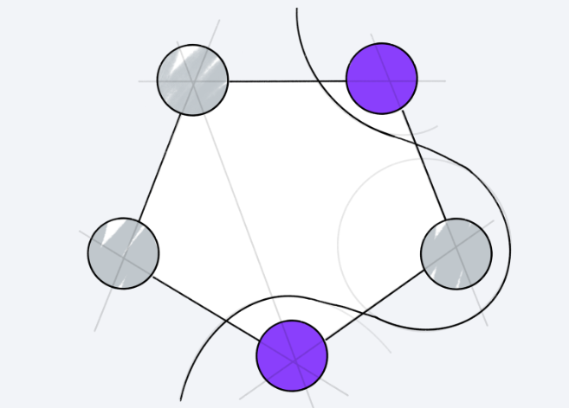
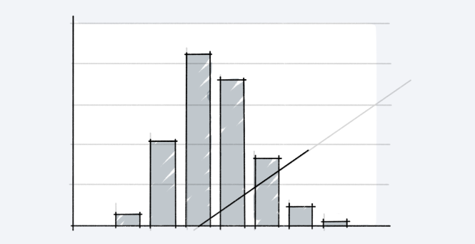
Application of Qiskit
Optimization
Finance
The Qiskit Optimization package covers the whole range from high-level modeling of optimization problems, with automatic conversion of problems to different required representations, to a suite of easy-to-use quantum optimization algorithms that are ready to run on classical simulators, as well as on real quantum systems.
The Qiskit Finance package contains components to load uncertainty models, e.g., for pricing securities/derivatives or analyzing the risk involved. It also contains data providers to source real or random data to finance experiments and together with the Qiskit Optimization package allows easy modeling of optimization problems as arising e.g. in portfolio management.

Slide 7
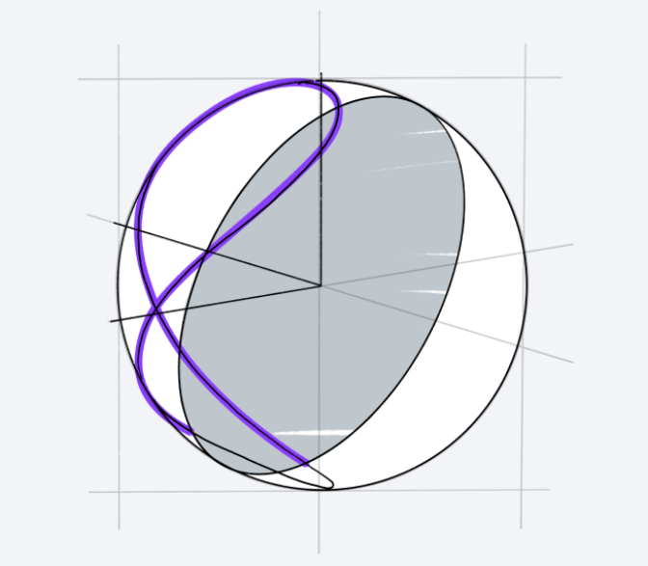
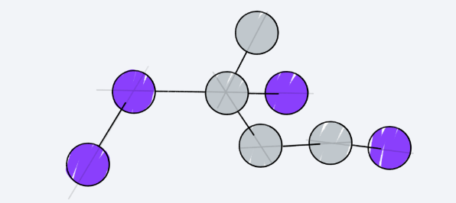
Application of Qiskit
Machine Learning
The Qiskit Machine Learning package simply contains sample datasets at present. Qiskit has some classification algorithms such as QSVM (Quantum Support Vector Machine) and VQC (Variational Quantum Classifier), where this data can be used for experiments, and there is also QGAN (Quantum Generative Adversarial Network) algorithm
Chemistry
The Qiskit Chemistry package supports problems including ground state energy computations, excited states and dipole moments of molecule, both open and closed-shell.

Slide 8
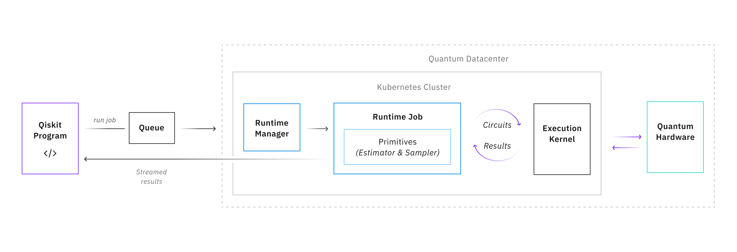
Qiskit Runtime overview
Overview
Qiskit Runtime is a quantum computing service and programming model that allows users to optimize workloads and efficiently execute them on quantum systems at scale. The programming model extends the existing interface in Qiskit with a set of new primitive programs.

Slide 9
Primitives
Primitives are predefined programs that provide a simplified interface for defining near-time quantum-classical workloads required to efficiently build and customize applications. The initial release of Qiskit Runtime includes two primitives: Estimator and Sampler. They perform foundational quantum computing tasks and act as an entry point to the Qiskit Runtime service.
Estimator
This is a program interface that takes circuits and observables and allows users to selectively group between circuits and observables for execution to efficiently evaluate expectation values and variances for a given parameter input. This primitive allows users to efficiently calculate and interpret expectation values of quantum operators required for many algorithms.
Sampler
This is a program that takes a user circuits as an input and generates an error-mitigated readout of quasiprobabilities. This provides users a way to better evaluate shot results using error mitigation and enables them to more efficiently evaluate the possibility of multiple relevant data points in the context of destructive interference.

Slide 10
Error Handling
This API uses standard HTTP response codes to indicate whether a method completed successfully.
A 200 response indicates success. A 400 type response indicates a failure, and a 500 type response indicates an internal system error.

Slide 11
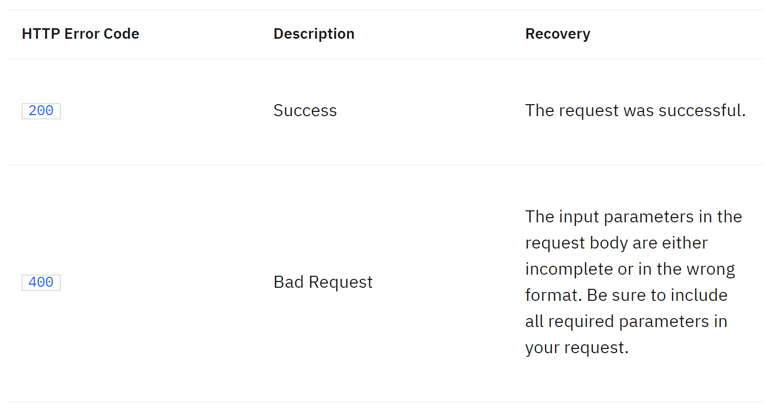

Slide 12
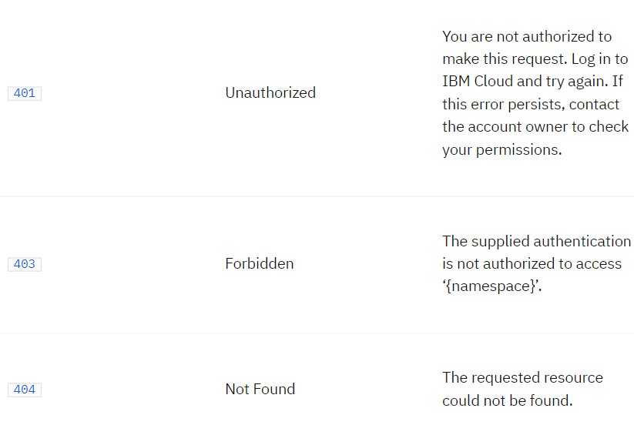

Slide 13
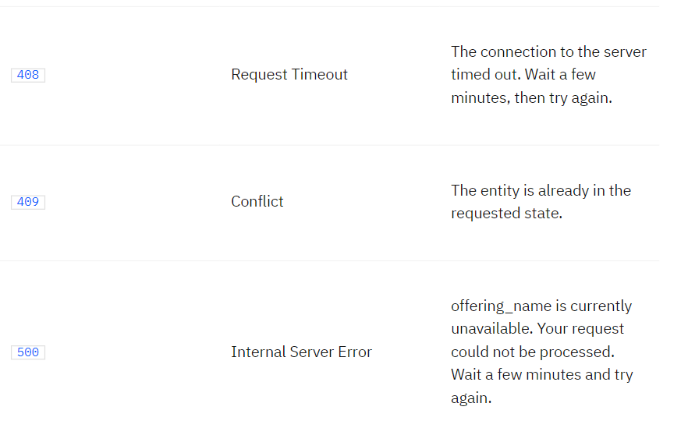

Slide 14
THANK YOU

